Slide 1

SREENIVASA INSTITUTE OF TECHNOLOGY AND MANAGEMENT STUDIES
(SITAMS)
(Approved by AICTE, New Delhi & Affiliated to JNTUA, Ananthapuramu) Chittoor - 517127, A.P., India.
Conversational Database Interaction Using LangChain and NLP
Guide : Mrs.R.Ramya Mam
Associate Professor
CSE – DS
Team Members : C.P. Susmitha 21751A3210
C. Jyoshitha 21751A3211
J. Hema Sree 21751A3221

Slide 2
Abstract
AI-powered NLP system that translates natural language queries into SQL for seamless database interaction. Automates SQL query generation and execution using LangChain, enabling data retrieval without SQL expertise. Enhances accessibility and decision-making by allowing non-technical users to extract insights from structured data effortlessly.
Keywords :- NLP, SQL, LangChain, AI

Slide 3
Introduction
This project integrates LangChain with SQL databases to enable natural language-based data retrieval without requiring SQL knowledge.
Users can query structured datasets like Chinook using plain English, with AI dynamically converting queries into SQL and returning results.
The system enhances data accessibility, business intelligence, and decision-making, making database interactions more intuitive for non-technical users.

Slide 4
Existing Systems
SQL Expertise Required – Traditional systems require users to have SQL knowledge, making data retrieval inaccessible for non-technical users.
Time-Consuming Process – Manually writing SQL queries, debugging errors, and understanding database schemas slow down decision-making.
Limited Flexibility – Fixed query structures restrict dynamic and conversational data exploration, making it difficult to adapt to varying user needs.

Slide 5
Proposing Systems
AI-powered NLP system that converts natural language queries into SQL, eliminating the need for SQL expertise.
Automated query generation and execution using LangChain and LLMs, enabling seamless database interaction.
Enhanced data accessibility and efficiency, allowing non-technical users to retrieve insights effortlessly.

Slide 6
Literature Review
Early Rule-Based Approaches – Initial NL2SQL systems like PRECISE and NALIR relied on grammatical rules and semantic parsing, but lacked adaptability and required extensive manual updates.
Machine Learning-Based Advancements – Models like SQLNet and Rat-SQL improved SQL generation using deep learning and schema encoding, but struggled with complex queries and domain adaptation.
Impact of Large Language Models (LLMs) – LLMs like GPT-3 and GPT-4 introduced few-shot learning and Chain-of-Thought prompting, improving query flexibility but facing challenges with ambiguity and conversational context.
Lang Chain's Modular NL2SQL Framework (Used in our project) – By integrating dynamic table selection, conversational memory, and hybrid query generation, LangChain enhances accessibility, accuracy, and real-time database interactions for non-technical users.
Referred from [10] AI-Augmented LangChain Article – Published in 2024

Slide 7
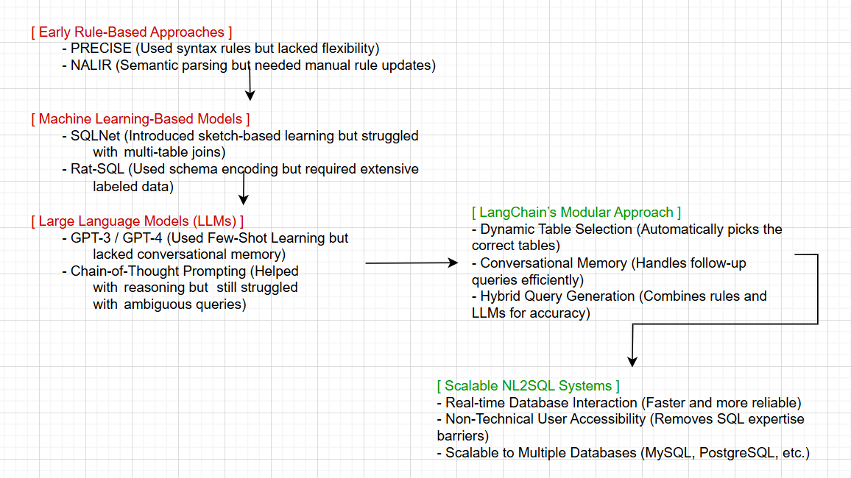
Why and How NL2SQL is implemented ?

Slide 8
Literature Review Examples
Approach | Example Query | How It Worked? | Limitation
Rule-Based (PRECISE, NALIR) | "Show all albums released after 2010." | Manually defined rules parsed keywords to generate SQL (SELECT * FROM albums WHERE release_year > 2010;) | Failed with complex queries like multi-table joins
Machine Learning (SQLNet, Rat-SQL) | "List the top 5 customers by total purchases." | Used deep learning to generate SQL (SELECT customer_id, SUM(total) FROM invoices GROUP BY customer_id ORDER BY SUM(total) DESC LIMIT 5;) | Required huge labeled datasets for every schema
LLMs (GPT-3, Few-Shot Learning) | "Find artists with more than 5 albums." | GPT-3 generated queries using few-shot learning (SELECT artist_id FROM albums GROUP BY artist_id HAVING COUNT(*) > 5;) | Struggled with ambiguous queries and lacked memory for follow-ups
LangChain | "Who are the top 5 customers and their total spend?" | Used context retention, schema awareness, and SQL optimization to generate correct queries | Solved previous challenges, enabling real-time, conversational database interactions

Slide 9
System Requirements
Hardware Requirements -
Processor (CPU) - Intel Core i5 (8th Gen) / AMD Ryzen 5
RAM - 8GB
Storage - 10GB SSD (for database + dependencies)
Graphics (GPU) - Integrated GPU (for basic LLMs)
Internet Connection - Required (for API access & package installation)
Software Requirements -
Operating System - Windows 10 / 11
Python Version - Python 3.8+
Database - MySQL
Programming Libraries - langchain, mysql-connector-python, sqlalchemy, langchain_openai, pandas, requests
API & AI Model - Together AI API (mistralai/Mistral-7B-Instruct-v0.1)
IDE / Code Editor - VS Code

Slide 10
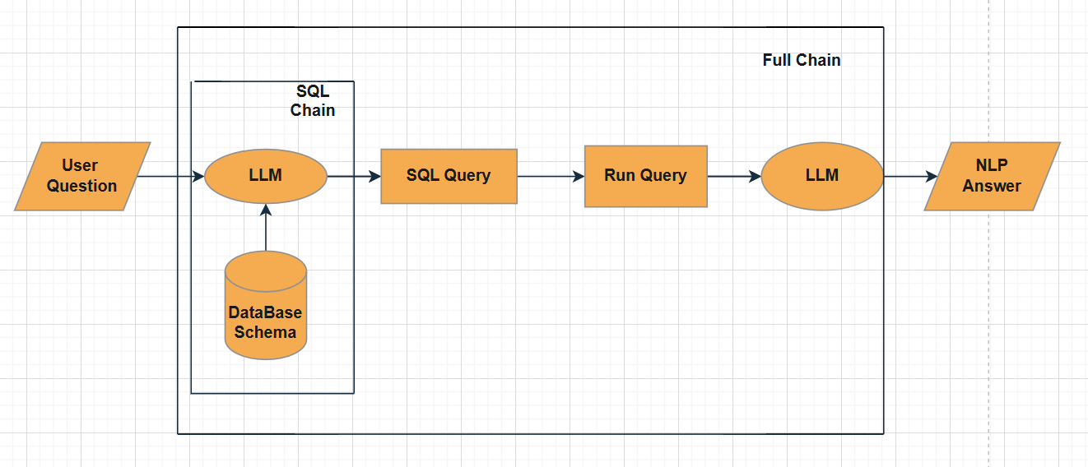
System Architecture

Slide 11
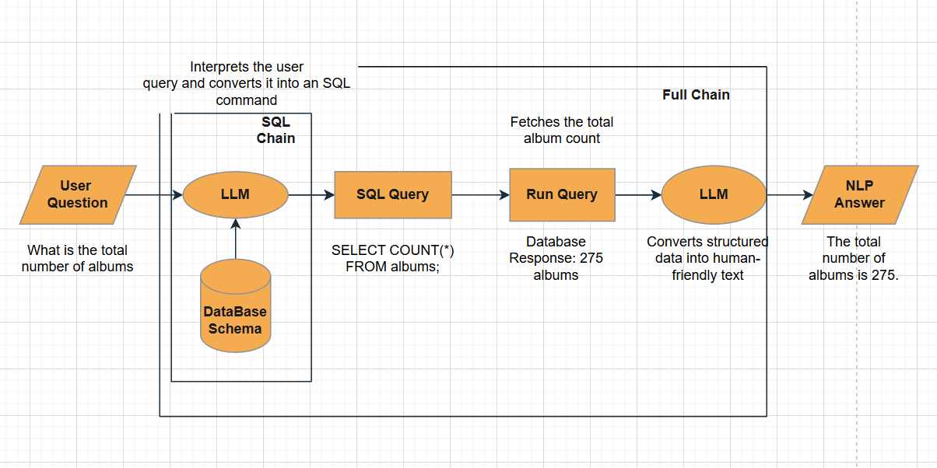
Sample Explanation Of Architecture

Slide 12
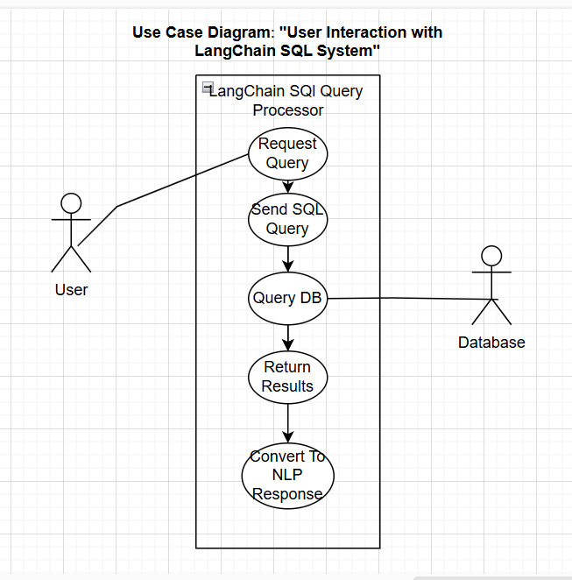
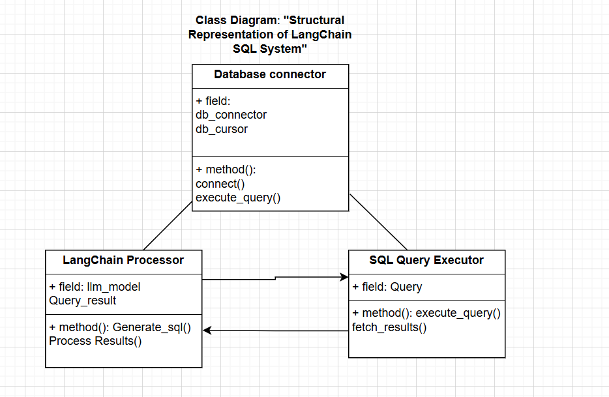

Design – Usecase And Class Diagram

Slide 13
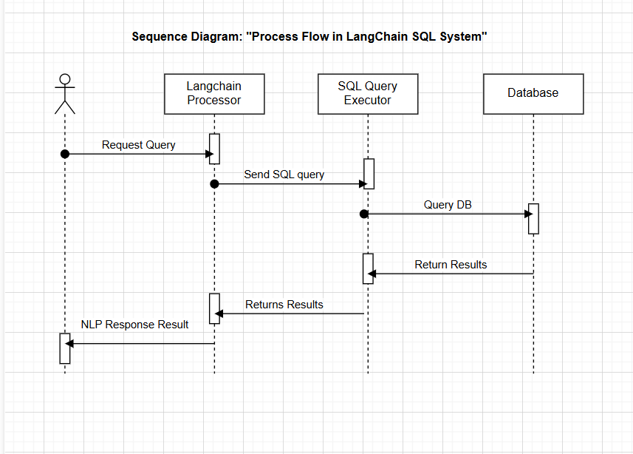
Design – Sequence Diagram

Slide 14
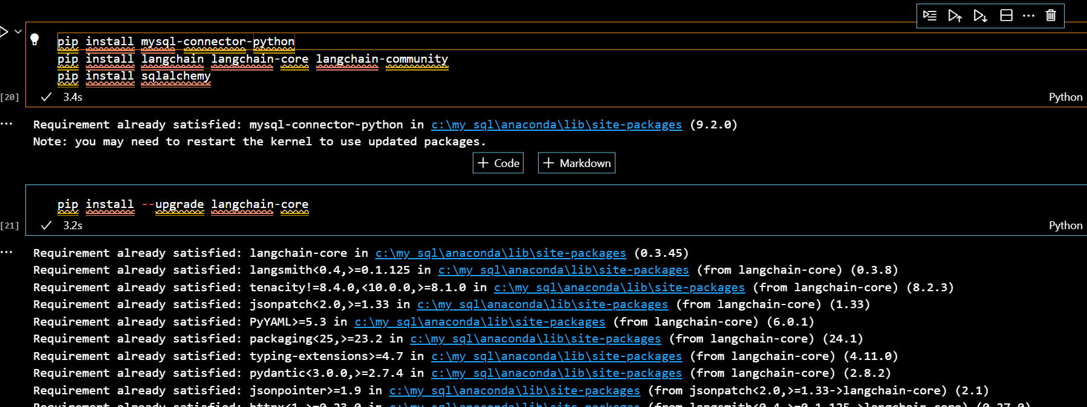
Implementation of Necessary packages
Install MySQL, configure authentication, and set up a test database.
Install Python and necessary packages like MySQL connector and LangChain.
Verify the installation by checking MySQL connection and package availability.

Slide 15
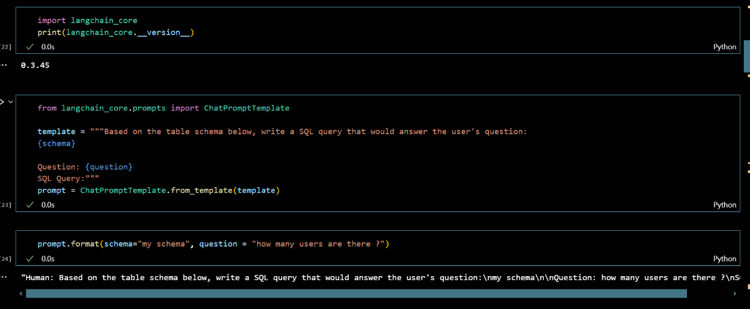
Implementation of SQL Chain Setup - Configuring the MySQL Connection
Establish a secure connection between LangChain and MySQL using database credentials.
Ensure proper authentication by handling special characters in credentials.
Retrieve and list available database tables to confirm a successful connection.

Slide 16
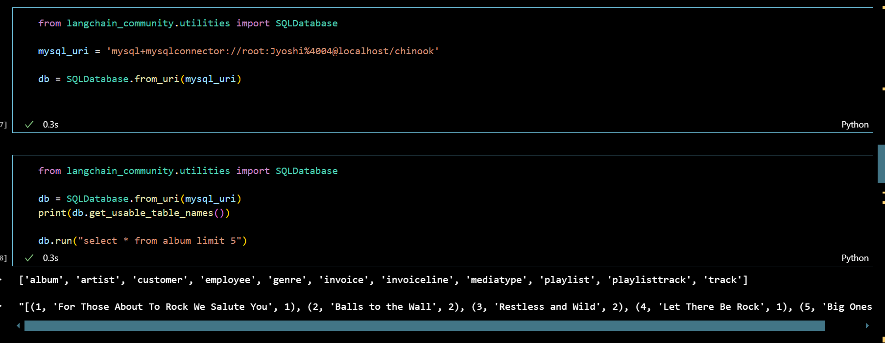
Implementation of SQL Chain - Running SQL Queries in the Chain
Execute SQL queries within LangChain to interact with the MySQL database.
Fetch and analyze data efficiently by using structured query execution methods.
Optimize queries for better performance and minimal processing time.

Slide 17
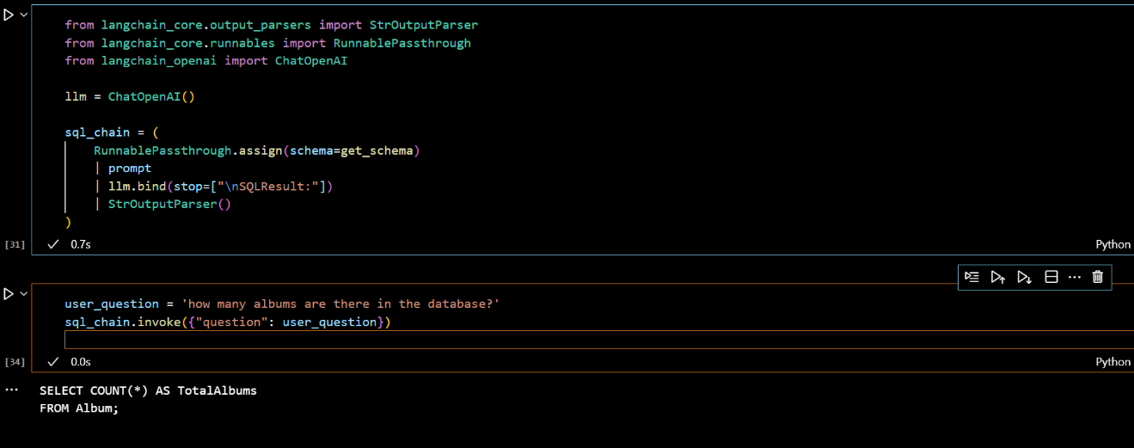
Implementation of SQL Chain - SQL Query Generation in LangChain
Generate SQL queries dynamically based on user input and database schema.
Use prompt-based AI models to convert natural language questions into SQL.
Integrate AI-powered query generation with automated execution in LangChain.

Slide 18
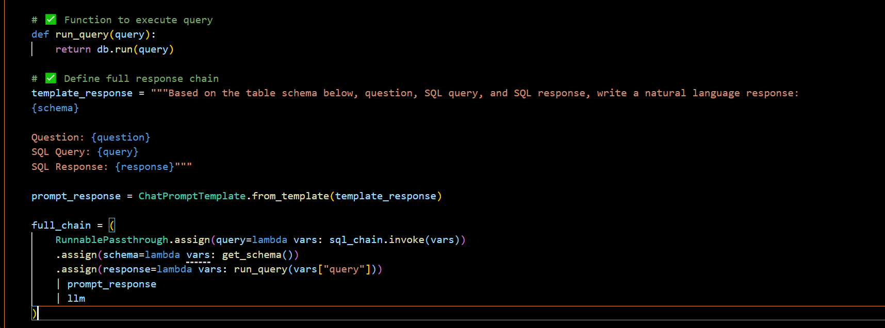
Implementation of LangChain – Running the SQL Query
Query Execution: The run_query(query) function executes the generated SQL query using db.run(query), fetching results from the database.
Processing Pipeline: The full_chain assigns the SQL query, schema, and response, executes the query, and passes the result to the language model.

Slide 19
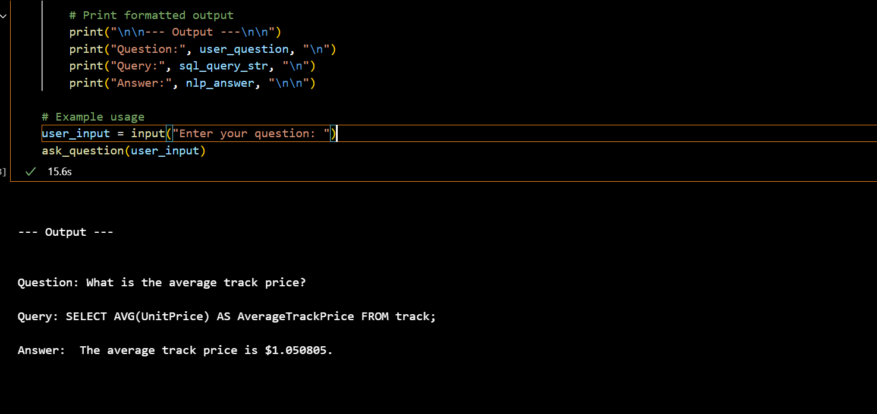
Implementation of LangChain – NLP Response
The function takes a user question, generates an SQL query using sql_chain, executes it via full_chain, and retrieves the NLP response.
It extracts the SQL query and NLP answer safely, then prints a structured output displaying the question, query, and natural language response.

Slide 20
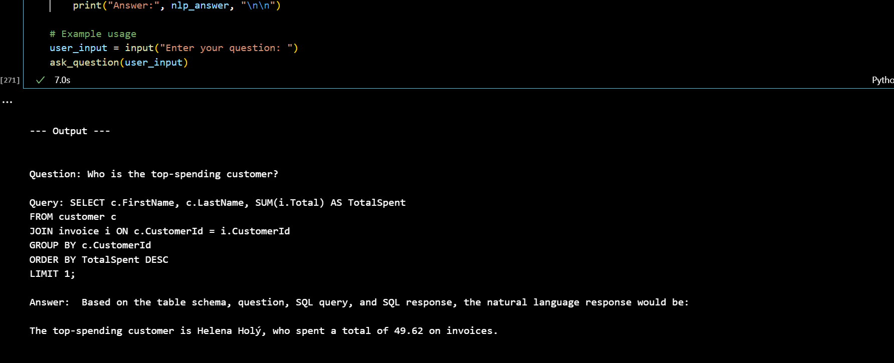
Testing
Question 1 : Who is the top-spending customer?

Slide 21
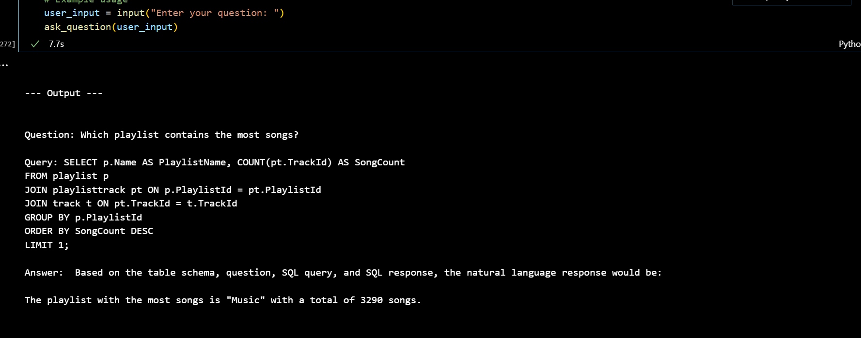
Testing
Question 2 : Which playlist contains the most songs?

Slide 22
Conclusion and Future enhancement
Conclusion: LangChain with SQL streamlines database querying and analysis through natural language, improving efficiency and flexibility.
Future Enhancements:
Improve LangChain's ability to generate complex and optimized SQL queries.
Add real-time data processing and enhanced security features like access control and encryption.

Slide 23
References
Data Source: https://github.com/lerocha/chinook-database
[1] Chowdhery A, Narang S, Devlin J, Bosma M, Mishra G, et al., "PaLM: Scaling language modeling with pathways," arXiv preprint, arXiv:2204.02311, 2022​.
[2] Dasgupta S, Ray S, Talukdar P, "LangChain: A framework for building applications with LLM APIs," arXiv preprint, arXiv:2211.03786, 2022​.
[3] Kojima T, Gu SS, Reid M, Gribovic Y, Neubig G, "Large language models are zero-shot learners," arXiv preprint, arXiv:2207.04344, 2022​.
[4] Scholak T, Schubotz M, Crain S, "Language models can explain their behavior on language tasks," arXiv preprint, arXiv:2212.09783, 2022​.
[5] Wei J, Tay Y, Raffel C, Zoph B, Abbeel P, et al., "Chain of thought prompting elicits reasoning in large language models," arXiv preprint, arXiv:2201.11903, 2022​.

Slide 24
References
[6] Guo J, Zhan Z, Gao Y, Xiao Y, Lou JG, et al., "Towards complex text-to-SQL in cross-domain database with intermediate representation," Proceedings of the Annual Meeting of the Association for Computational Linguistics, 2023​.
[7] Hwang W, Yim J, Park S, Seo M, "WikiSQL with table-aware word contextualization," arXiv preprint, 2023​.
[8] Wang C, Liang P, Manning CD, "Rat-SQL: Relation-aware schema encoding and linking for text-to-SQL parsers," Proceedings of the Association for Computational Linguistics, 2023​.
[9] Zhong V, Xiong C, Socher R, "Seq2SQL: Generating structured queries from natural language using reinforcement learning," arXiv preprint, 2023​.
[10] AI-Augmented LangChain: Facilitating Natural Language SQL Queries for Non-Technical Users, Arpan Shaileshbhai Korat, 2024

